Slide 1

ReSharper Course
Making Waves @ Oslo 2012

Slide 2

Me
Rasmus Kromann-Larsen
Danish .NET Developer
Active in Community
JetBrains Academy Expert

Slide 3
You?
.NET Developer?
ReSharper level?
Beginner?
Intermediate?
Expert?
Expectations for today?

Slide 4
Course Form
Focus on general important features
Lots of exercises
Introduction
Follow-up
Exercises

Slide 5
Hands-on Setup
Pairs
Driver
Navigator
Provides guidance and overview
Shortcut helper
Solo

Slide 6
Focus: More Keyboard
Productivity
But!
Steeper learning curve
Today: No deadlines. More keyboard.

Slide 7
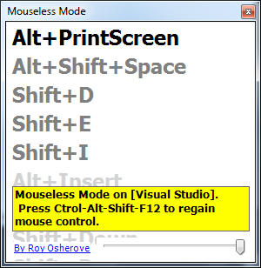
Keyboard Jedi
Presentation tool by Roy Osherove
Has a mouseless mode
Focused window
Alt + Ctrl + Shift + F12

Slide 8
Demo
Class: Plan
Name (string)
Documents (IEnumerable<Document>)
SecurityClassification (SecurityClassification)
Class: Document
Plan takes data via contructor and exposes it as read only properties
No ReSharper (for me, not you ☺)

Slide 9
First Excercise
Exercises:
http://bit.ly/resharperexercises
Pair
Navigator times it
Solve exercise as you normally would
Try without mouse

Slide 10
First Exercise follow-up
Times?
Experiences?

Slide 11

ReSharper - What?
Visual Studio add-in
Replaces
Background compliation
Navigation
Refactoring
IntelliSense
...

Slide 12

ReSharper - Why?
Keyboard-oriented
Productivity
Contextual
Intuitive help
Code over Text
Less Friction
More experimentation

Slide 13

ReSharper – How?
Pick Keyboard Scheme
Visual Studio
IDEA / IntelliJ
Take this course ☺
Use cheat sheet
Learn a new shortcut / day / week
Notes:
Visual Studio has less overlap with existing shortcuts. Makes it easier for people who don’t use ReSharper.
IDEA / IntelliJ is similar to other JetBrains products.
Recommendation: Visual Studio

Slide 14
Developer Time

Slide 15
Developer Time

Slide 16
Developer Time

Slide 17
Developer Time

Slide 18
Developer Time

Slide 19
Developer Time

Slide 20
Reading Code
Amount of code increases
We’re expected to keep up
We’ll look at tools for
Easy navigation
Reasoning about code
What you were thinking 6 months ago?
Debugging

Slide 21
Writing Code
Increase productivity
Done faster
More experimentation
We’ll look at tools for
Implementing new features
Changing existing code
Restructuring projects

Slide 22
Rest of the day
ReSharper Demo
Break
Exercises
Break
Exercises
Break
Wrap-up

Slide 23
Demo

